Slide 1
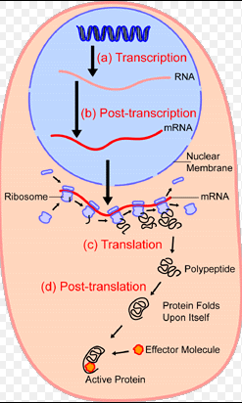
THE CELL

Slide 2
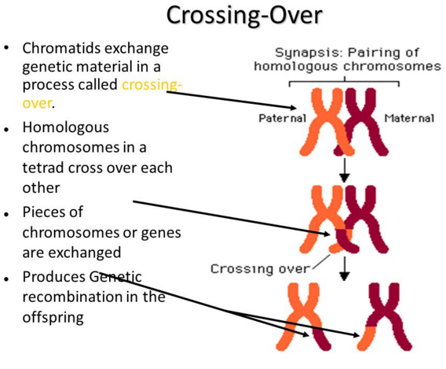

Slide 3
DNA Functions
Stores genetic information to build and maintain a living organism
Copies itself

Slide 4
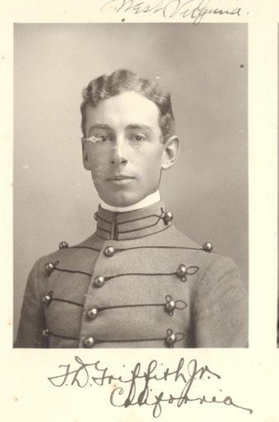
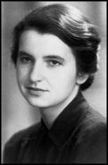
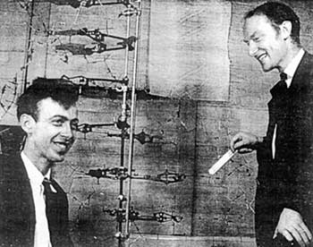
HISTORY OF DNA
Discovery of the DNA double helix
A. Frederick Griffith – Discovers that a factor in diseased bacteria can transform harmless bacteria into deadly bacteria (1928)
B. Rosalind Franklin - X-ray photo of DNA (1952)
C. Watson and Crick - described the DNA molecule from Franklin’s X-ray (1953)

Slide 5

James Watson & Francis Creek 1953
Determined the three-dimensional structure of DNA
One of the greatest discoveries in the history of science
Nobel prize in 1962

Slide 6
DNA Double Helix
“Rungs of ladder”
Nitrogenous
Base (A,T,G or C)
“Legs of ladder”
Phosphate &
Sugar Backbone

Slide 7
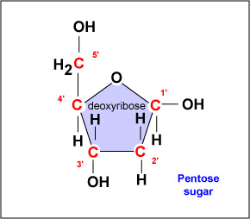
Carbons in the sugar are labeled 1’
(one prime)
to 5’.

Slide 8
DNA Nucleotide
Phosphate
Group
O
O=P-O
O
5
CH2
O
N
Nitrogenous base
(A, G, C, or T)
C⁴
C¹
Sugar
(deoxyribose)
C³
C²

Slide 9
BASE-PAIRINGS
H-bonds
G
C
T
A

Slide 10
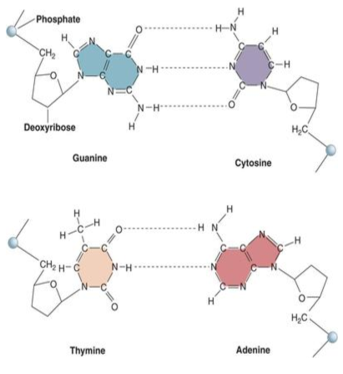
Purines and Pyrimidines are nitrogenous bases that make up the two different kinds of nucleotide bases in DNA and RNA. The two-carbon nitrogen ring bases (adenine and guanine) are purines, while the one-carbon nitrogen ring bases (thymine and cytosine) are pyrimidines.

Slide 11
Base Pairing Rule
Adenine pairs with Thymine
Guanine pairs with Cytosine

Slide 12
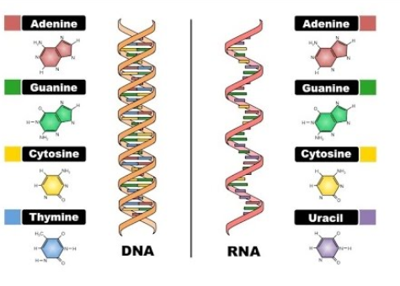

Slide 13
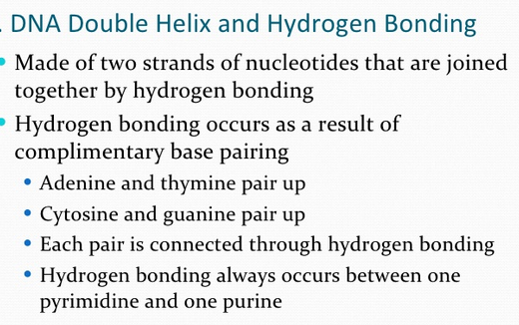

Slide 14
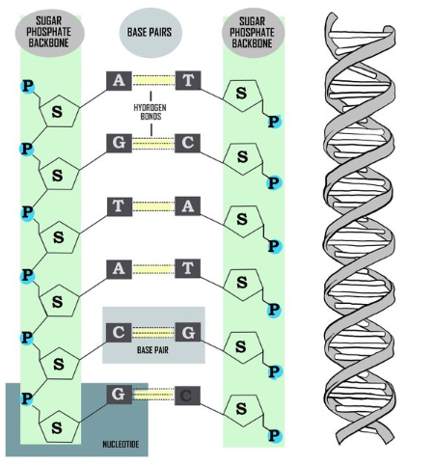
Deoxyribonucleic acid (DNA) is double helical long double-stranded chain of nucleotides
DNA is the hereditary material passed on from generation to generation.
DNA is made up of four nucleotides: A, C, G, and T.
A always pairs with T.
C always pairs with G.
The two strands of DNA are in an antiparallel configuration.
Two complementary DNA strands will separate when heated, and will spontaneously pair together again (hybridize) when cooled.

